Slide 1
CIS Steam Camp 2018: Waterkinesis
Danielle Olson & Lily Zhang

Slide 2

Goals
Let the students have fun with science to create a project that’s inspiring and hopefully sparks scientific excitement!
→ Waterkinesis: Control objects in water with your mind!
Use the Muse headsets to read brain movement
Use the Lego WeDo to create a waterproof, moving device
Control the Lego WeDo using EEG waves from the Muse headset
Notes:
A kinesis is an automatic and immediate change in your activity due to some sort of a stimulus. 'But what is a stimulus?' you might ask. A stimulus is anything that causes an action or reaction from something else.

Slide 3
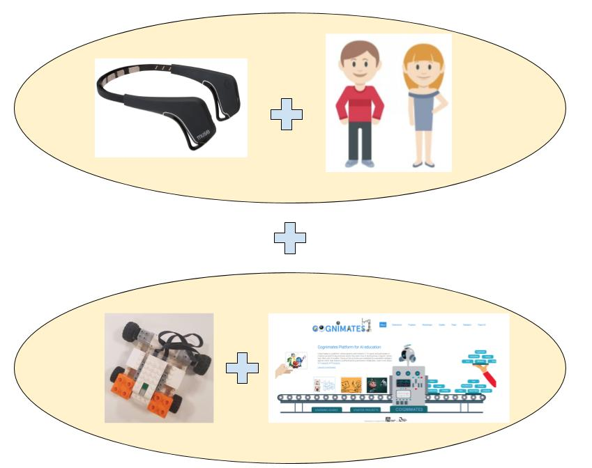
Big Idea
Muse headset records your data and sends it over to Cognimates
Lego Wedo is programmed on Cognimates using the Muse data to move the motor

Slide 4
About EEG

Slide 5
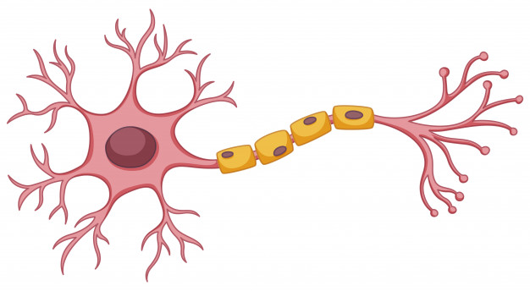
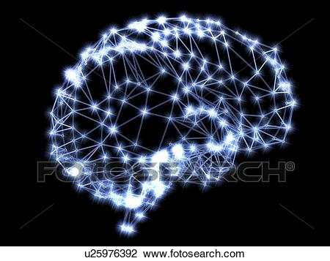
About the Brain
Your brain is made up of billions of nerve cells called neurons, connected to each other in networks

Slide 6
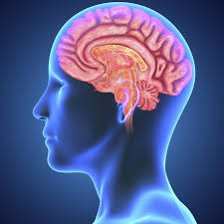
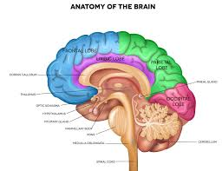
About the Brain
Every time you make a movement or have an emotional response, your brain also experiences lots of activity!
The brain fires messages across networks to say things like “our human is now moving his left arm” or “our human is now blinking”

Slide 7
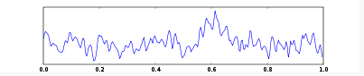
What is EEG?
EEG stands for Electroencephalography
EEG is what we use to record brain activity in the form of graphs, just like you can record your heartbeat on a graph and see it on a heartbeat monitor
One second of EEG signal

Slide 8
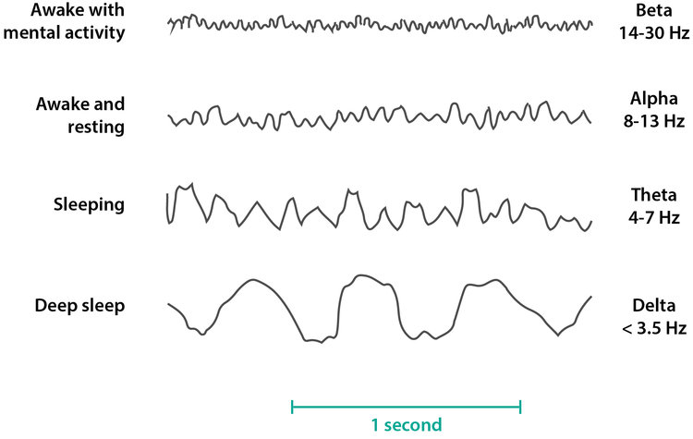
Different types of EEG signals
Your brain emits different types of waves depending on your state - whether you’re awake or asleep, relaxed or distressed
Based on emotions and actions, the graphs will record different patterns and different types of waves
Different signals and
graphs depending on
different states

Slide 9
About Muse

Slide 10
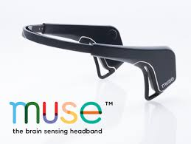
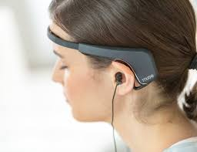
What is Muse?
The Muse headband was made so that you can track your brain activity as you meditate
Knowing what your brain activity looks like (steady or unsteady) can help you focus on relaxing rather than stressing
The headband is an easy way for us to record our EEG data

Slide 11
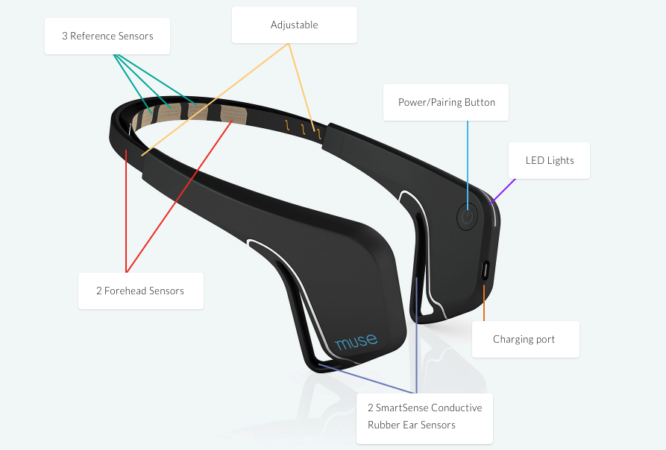
Muse headband structure
The headband is used to detect and measure the activity of your brain, and it uses 7 finely calibrated sensors to do so.
There’s 2 sensors on the forehead, 2 behind the ears, and 3 additional reference sensors in the middle of your forehead.
Muse headband diagram
(Credit: Muse website)

Slide 12
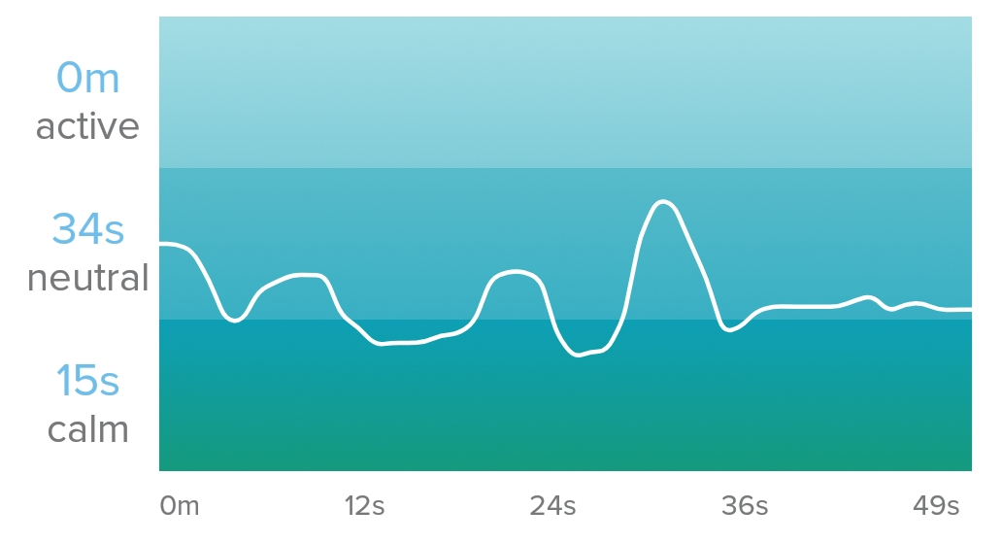
How it works
The headband starts by calibrating, which means it records your brain waves for a few seconds when you’re in a resting, calm state. This sets an example for what “relaxed” looks like in your brain. Then, it records you!
Example graph from 50 seconds on the Muse app - The first bump around 10s was right arm movement, the second bump around 20s was left arm movement, and the last big bump around 30s was a strong blink.

Slide 13
LEGO WeDo

Slide 14
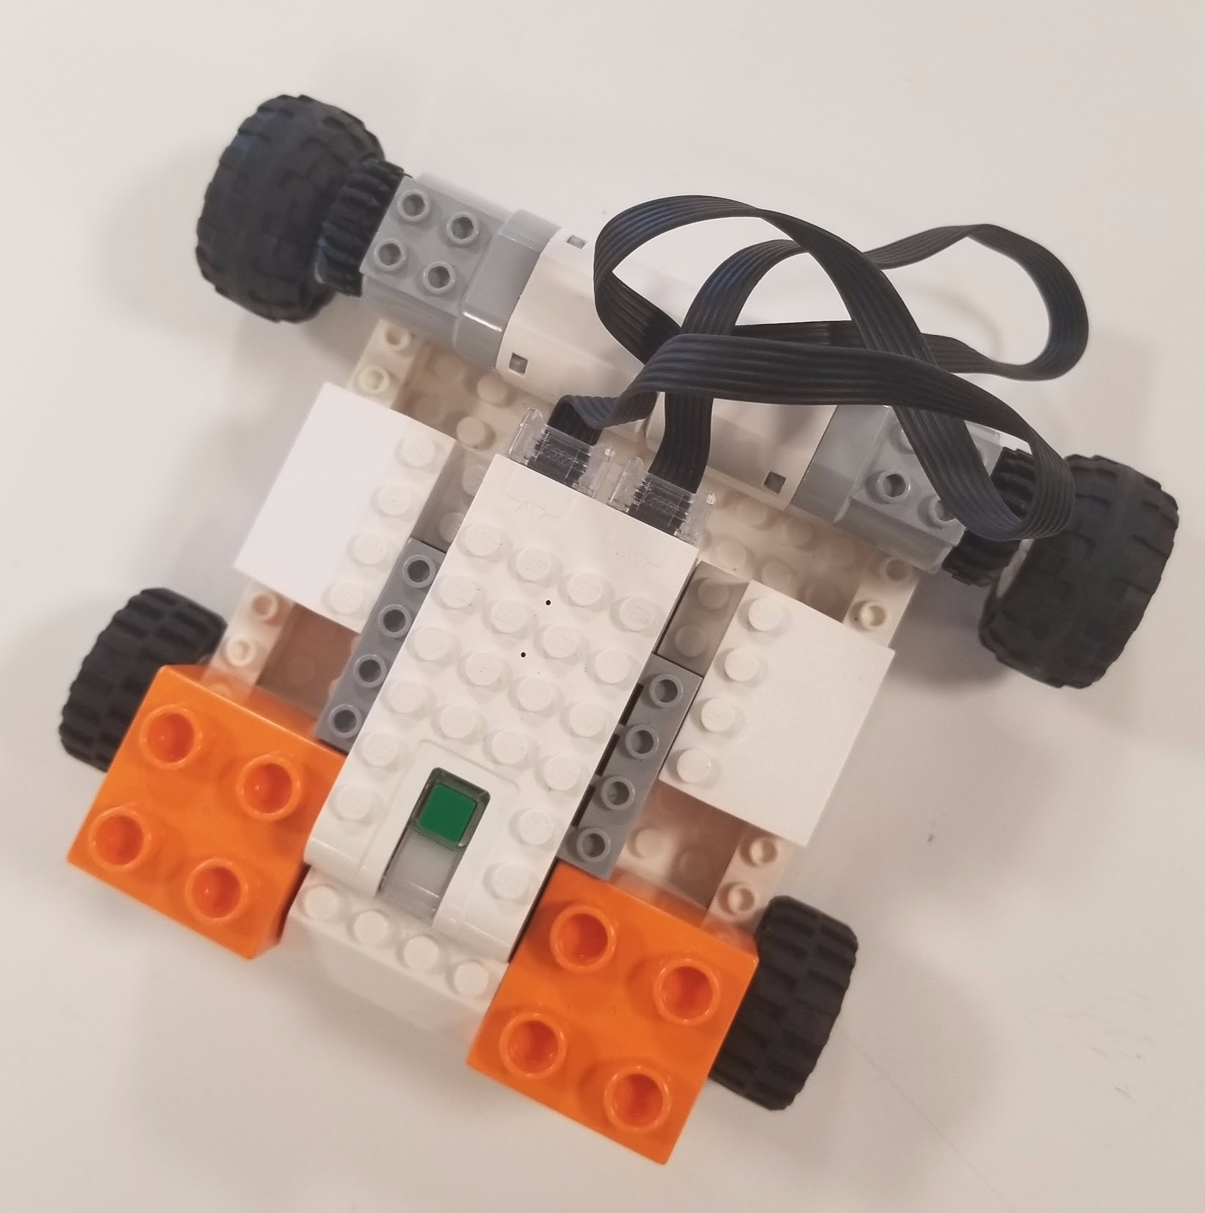
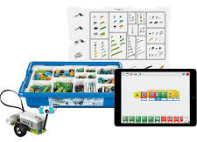
What is a LEGO WeDo
The LEGO WeDo is a hands-on STEM product created to combine the LEGO brick with classroom-friendly software
Today, we will use the LEGO WeDo extension on Cognimates to get the motor to move based on Muse inputs

Slide 15
Getting Started

Slide 16

Online Questions - Robots
bit.ly/WK-robot
bit.ly/WK-muse

Slide 17
Let’s share!
What would you teach a robot?

Slide 18
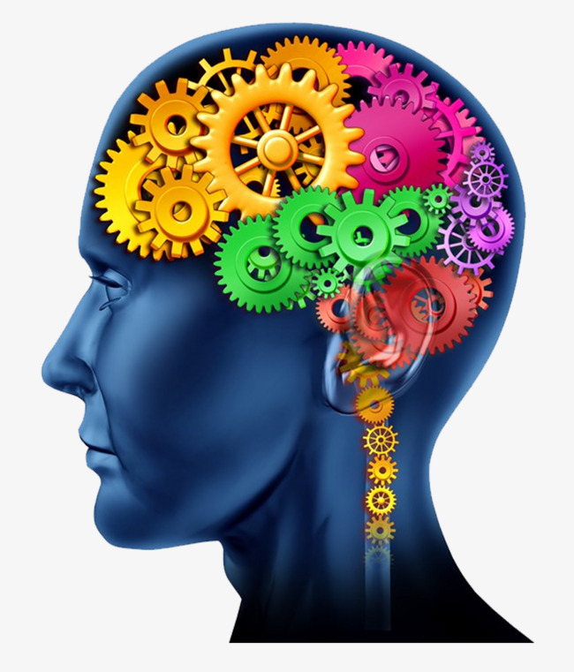
Online Questions - Brain
bit.ly/WK-muse

Slide 19
Let’s share!
What would you do with brain-computer communication?

Slide 20
Cognimates

Slide 21
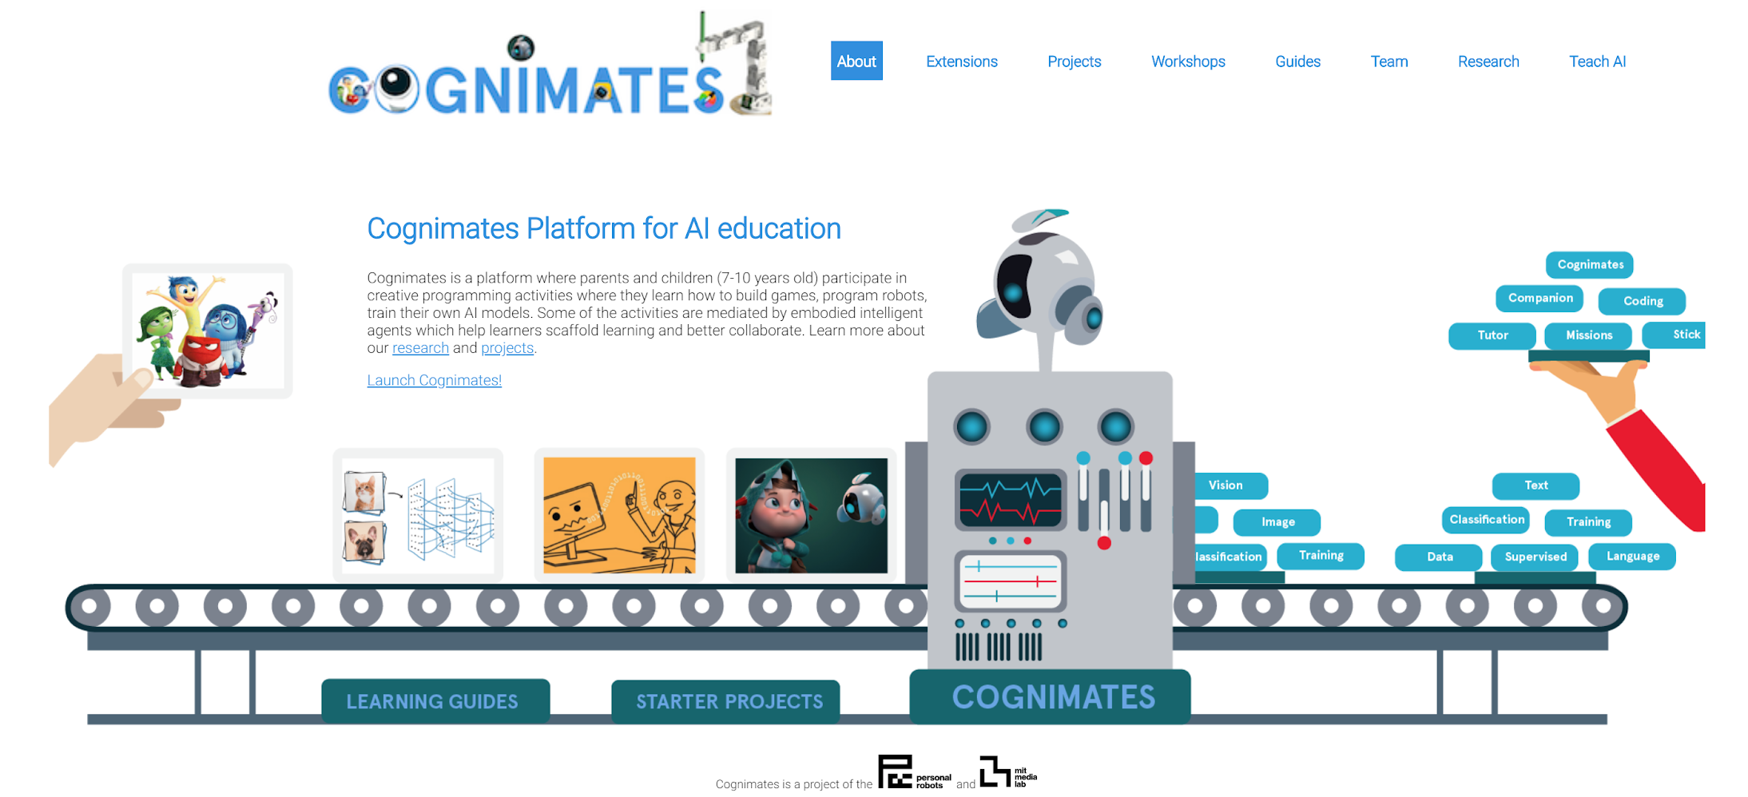
What is Cognimates
Cognimates is a platform where you (and your parents!) can participate in creative programming activities
Learn how to build games, program robots, or train your own Artificial Intelligence models (like text or speech recognition)
Website:
cognimates.me/

Slide 22
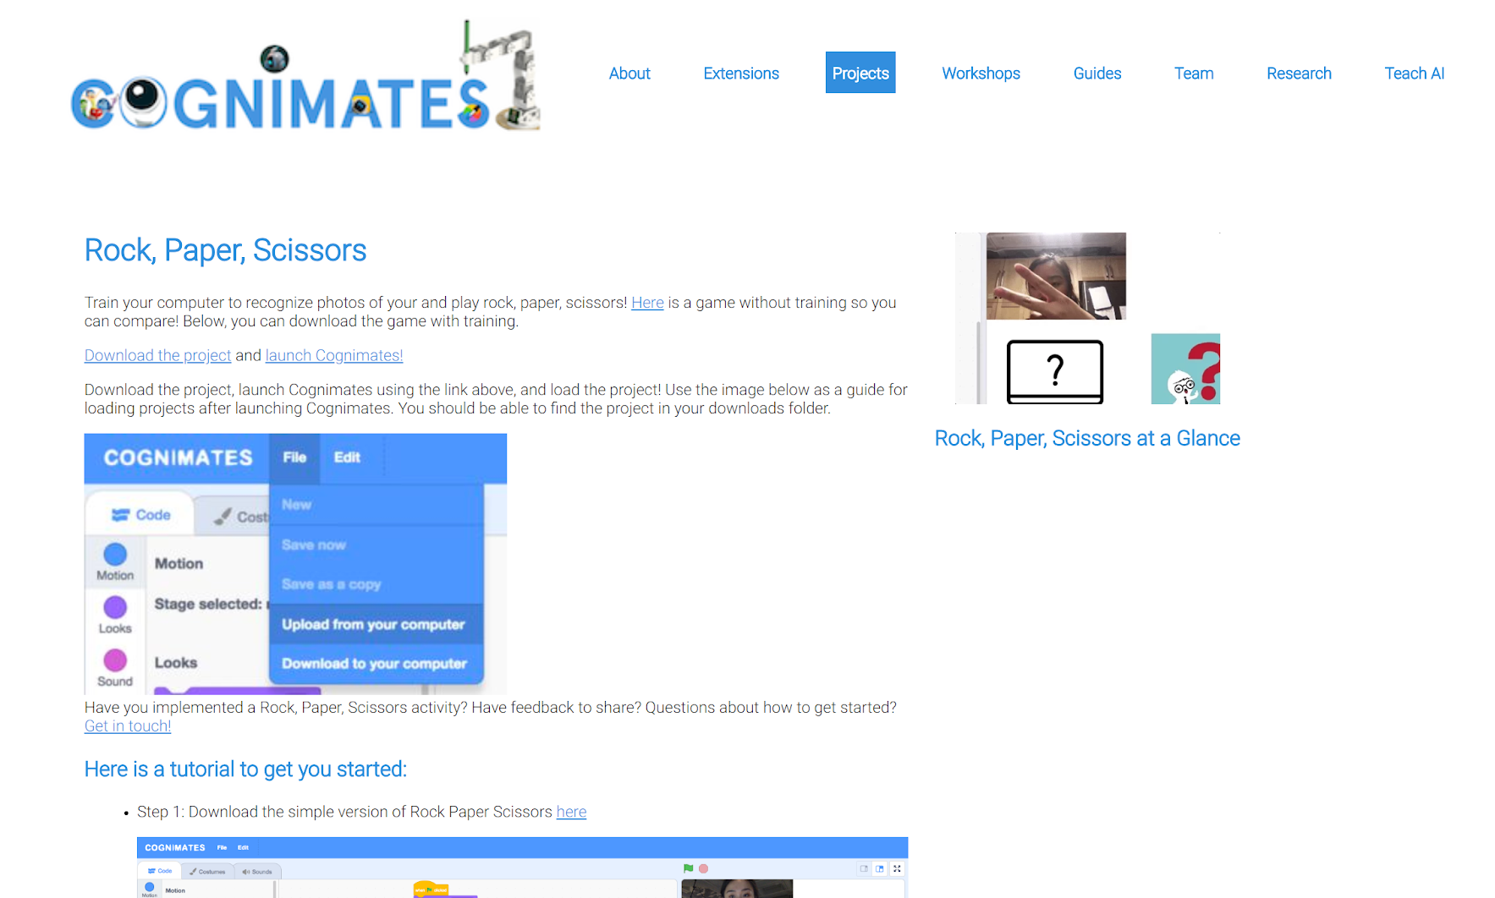
How to use Cognimates
Go to the “projects” tab on the Cognimates website
Pick a starter project, and follow the guided steps to get started!
Example starter project where you train your computer to recognize photos of your hands and play rock, paper, scissors!

